Slide 1
What is it to be a System Administrator?
Marian Marinov
CEO of 1H Ltd.
mm@1h.com

Slide 2
What are the tasks of the SysAdmin?
How to become SysAdmin?
How to keep my Job?

Slide 3
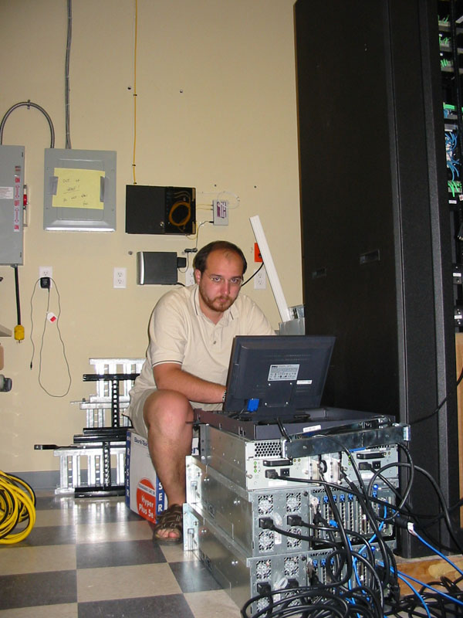
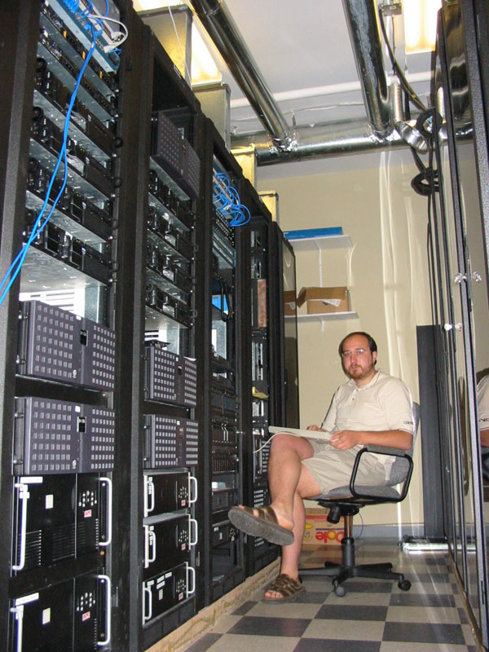

When the work goes according to plan

Slide 4
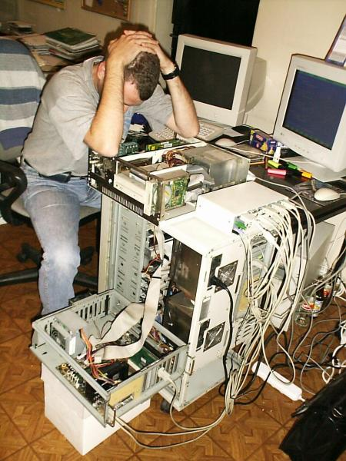
And when it doesn't

Slide 5
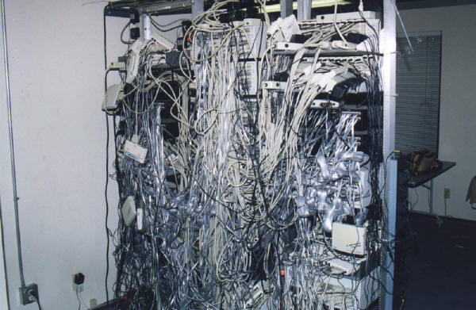
We manage to find our way in this jungle

Slide 6
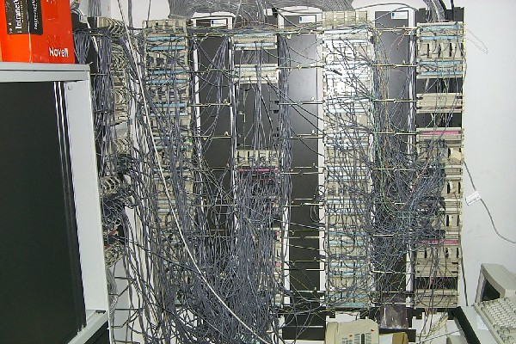
And other

Slide 7
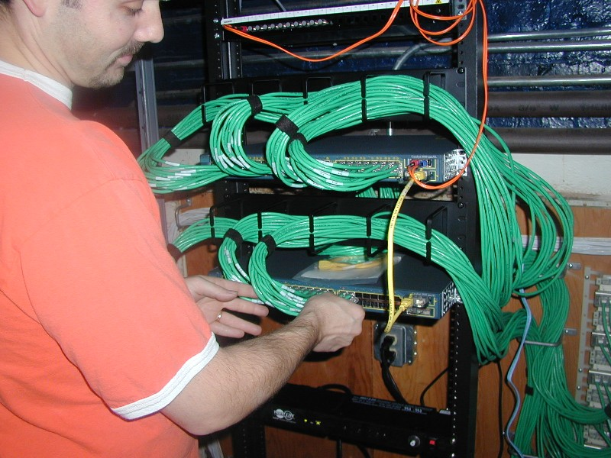
And bring order

Slide 8
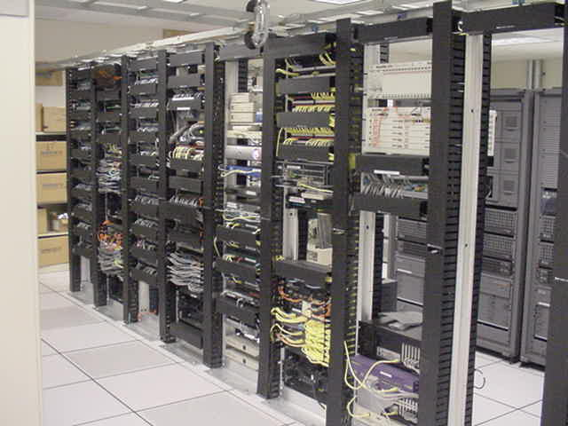
And discipline

Slide 9
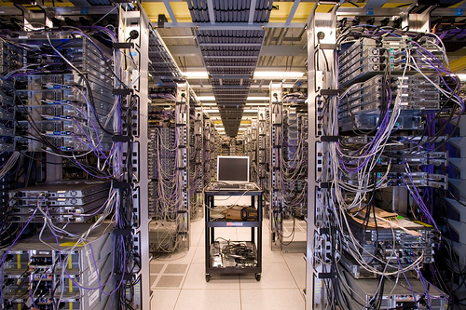
We are allowed to play with toys like these

Slide 10
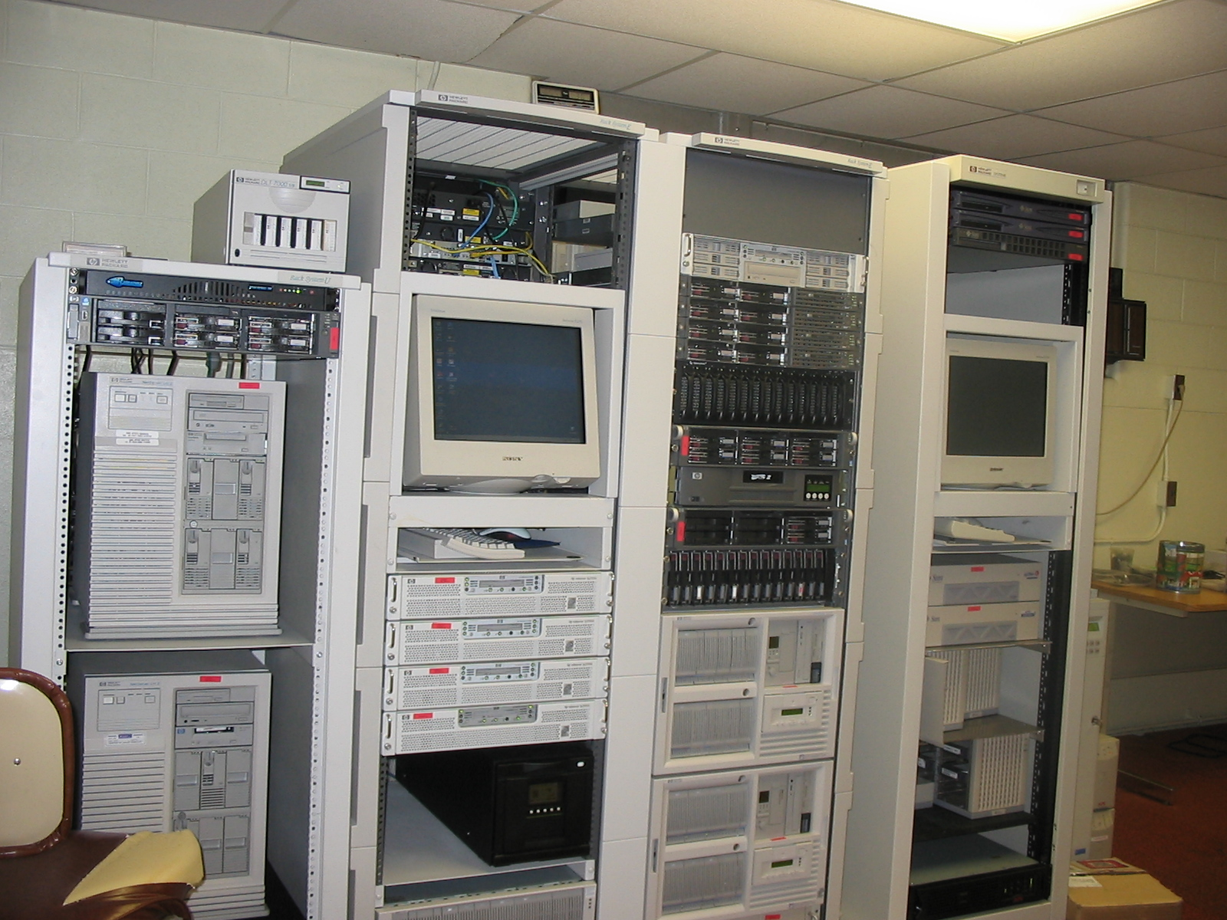
And these

Slide 11
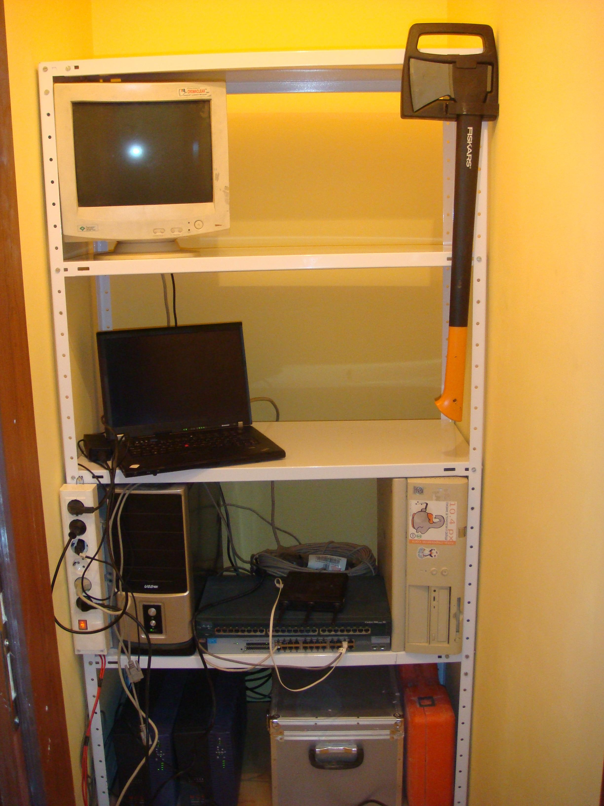
And some of us even have similar at home.

Slide 12
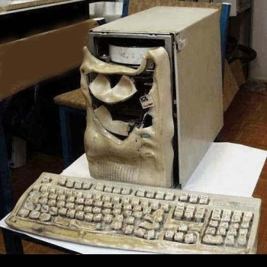
Some times we receive complains that something has broken

Slide 13

We would be willing to help to some users

Slide 14

To others...
Not quite so...

Slide 15

Mainly the work of the SysAdmin requires a lot of typing

Slide 16
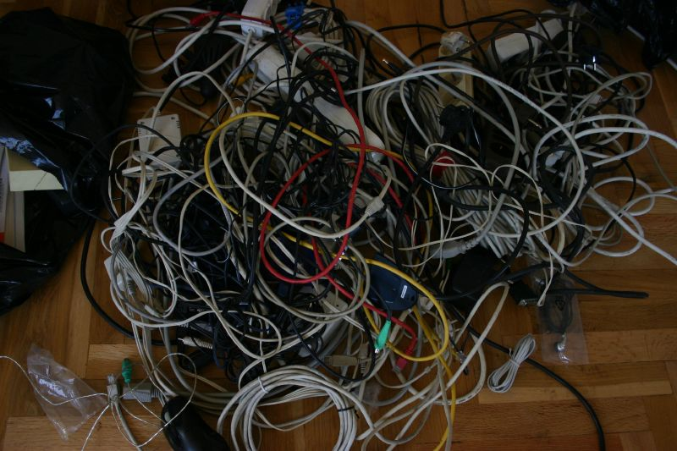
And a lot of wires

Slide 17
So, how to become System Administrator
There are 3 MAIN things

Slide 18

Visit courses like this one

Slide 19

Get to know your hardware

Slide 20
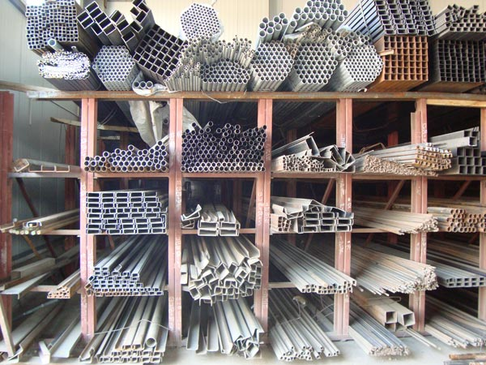
Know your IRON (Pernik)
Computers
    PC
    MAC
Networks
    Switchs
    Routers
    WiFi
And in recent times
    Electricity
    HVAC - heating, ventilation, and air conditioning

Slide 21







And your software
How to find relative information
Distributions
Knowing everything in your system
Willingness get your hands dirty
BE LAZY
And don't give anything away without a fight

Slide 22

How to learn everything?
One by one, find every software installed on
your machine and start learning how it works.

Slide 23
Why you have to get your hands dirty?
Shell scripting
Fix simple programming mistakes
Find additional documentation
How to do that?
Bash
Perl/Python
C/C++

Slide 24
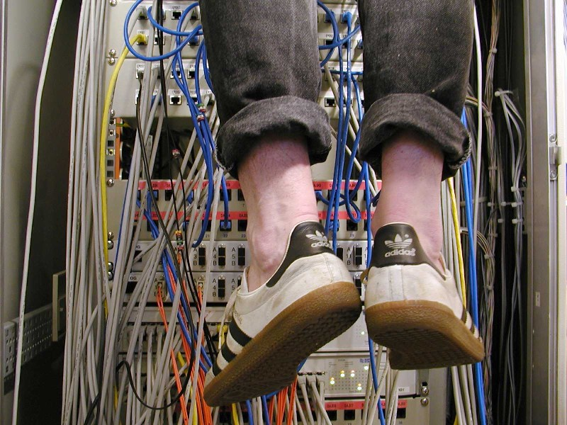
So, how to NOT get fired?

Slide 25
So, how to NOT get fired?
Keep your machines up-to-date
Keep track of security mailing lists
Do not write or allow simple passwords
Do not give away passwords and access
Be strict in implementing the above tasks

Slide 26

What is it to be a System Administrator?
http://academy.telerik.com/student-courses/software-technologies/os-windows-linux/

Slide 27
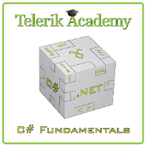



Free Trainings @ Telerik Academy
C# Programming @ Telerik Academy
    csharpfundamentals.telerik.com
  Telerik Software Academy
    academy.telerik.com
  Telerik Academy @ Facebook
    facebook.com/TelerikAcademy
  Telerik Software Academy Forums
    forums.academy.telerik.com

